Slide 1
MIM Dual Degrees Capstone · Praxis MMT39 · CEO Meeting 1
Company 3
Year 1 review and Year 2 plan
No. 1
of 5 companies
on net income and on accumulated profit
Simulation B1SIM2C2 · Virtual Year 1 closed
Presented by the management team of Company 3
Sources: Year-1 REP p.4–p.6 and p.8; Surveys 1, 2, 3 and 23.

Slide 2
How we will use the time
Managing Director
Agenda and speaking roles
Agenda
Who presents what
1
Introduction
Market size, strategy, brand and share goals
sl. 3–6
Managing Director
[Name]
sl. 1–6, 11, 24–26, 34–36
Strategy, market and competitor read, causes, objectives, board Q&A
2
Summary of results
Revenue, profit, margins, ROE, sales and share
sl. 7–10
Marketing Director
[Name]
sl. 9, 12–15, 27
Portfolio, positioning, price, distribution, advertising, promotions
3
Analysis and causes
Marketing, operations, HR, finance — why
sl. 11–24
Operations Director
[Name]
sl. 16–18, 28
Capacity, production plan, unit cost, supply chain, logistics
4
Objectives
Specific and measurable targets for Year 2
sl. 25–26
HR Director
[Name]
sl. 19–20, 29
Headcount, salaries, turnover, training, sales-force incentives
5
Actions
Marketing, operations, HR, finance decisions
sl. 27–30
Finance Director
[Name]
sl. 7–8, 10, 21–23, 30–33
P&L, balance sheet, ratios, cash, financing, forecast
6
Financial forecast
Projected income statement, band, alternatives
sl. 31–36
Replace [Name] before the meeting. If the team is four, the Managing Director also carries the Finance Director's slides — the roles are not merged, both are presented.
Source: 2026 MIM evaluation guidelines — the six sections are prescribed in this order, and each member's role must be identified on the slides.

Slide 3
1
Introduction
The market we compete in · What kind of company we are · Goals for brand perception and market share Presented by the Managing Director

Slide 4
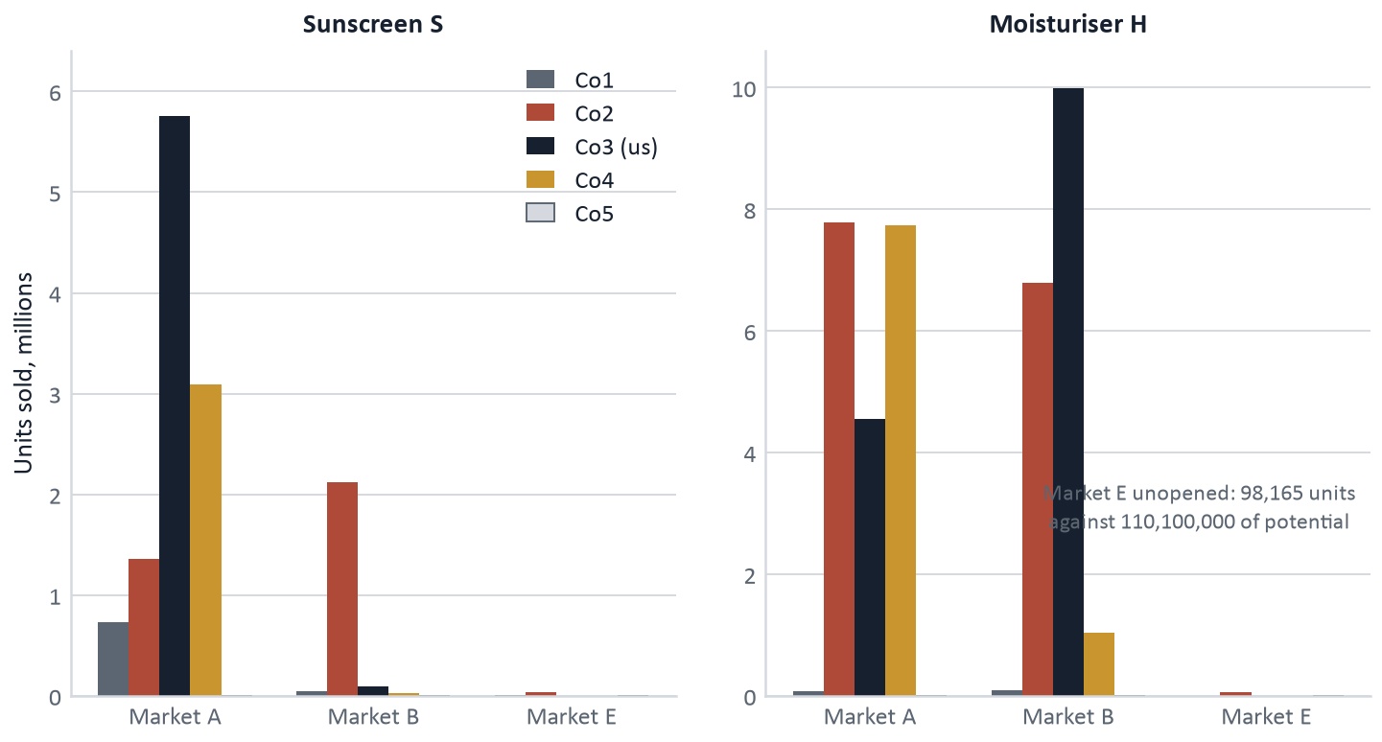
Section 1 · Introduction
Managing Director
The market we compete in
What the market looks like
51,380,110 units were sold by the five companies in Year 1. Moisturiser H is 74% of that volume, sunscreen S 26%.
Market A is the volume market for both products: 31.1 M units against 20.2 M in market B.
Market E is effectively unopened — 98,165 units between the two companies that entered, against 110,100,000 of potential.
We are the largest seller in the industry: 20,396,301 units, 39.70% of everything sold.
Only two of the five companies are real competition. Co1 and Co5 together sold 953,809 units and both lost money.
Sources: Survey 3 (units by company, product and market), Surveys 1 and 2 (participants' totals), Year-1 REP p.2–p.3. Potential from the scenario, §2 × §3.

Slide 5
Section 1 · Introduction
Managing Director
The strategy: what kind of company we are
The premium brand of the industry, and the most profitable one.
1 Premium, not cheap
S positioned at (1, 8) — the quality corner — and priced at €14.50, the highest in the industry in every channel.
Evidence: 52.67% of market A at 71% above the cheapest rival, and we sold out.
2 Two products, two jobs
S is the margin engine at €6.9511 of gross profit per unit. H is the volume and cash engine: 14,546,301 units, 55.2% of revenue.
Evidence: S gross margin 55.2%, H 61.2% — see slide 10 on why H's flatters.
3 Scale where we already win
Grow A and B to their limit before spending a euro on market E. Enter E only when a survey says it can pay.
Evidence: E delivered 98,165 units across the whole industry in Year 1.
4 Self-financed growth
Fund capacity and stock from operating cash, not from debt. Every euro of interest is a euro of margin given away.
Evidence: €3,060,000 of financial expense while holding €46,902,208 of cash.
Sources: Year-1 REP p.2–p.6; Surveys 7, 8 and 20; DEP decision sheet. Gross profit per unit from REP p.4 standard costs.

Slide 6
Section 1 · Introduction
Managing Director
Goals: brand perception and market share
Brand perception — where we stand and where we go
Brand | Position (X, Y) | Nearest rival | Goal for Year 2
S — markets A and B | (1, 8) quality corner | Co4 (2, 8) · Co2 (3, 8) | Hold. Highest price in the industry, top-left corner, unchanged
H — markets A and B | (9, 1) value corner | Co2 sits on the same (9, 1) | Hold the position, close the price gap to Co2 by raising A to €7.50
Market share — Year 1 achieved and Year 2 target
 | S in A | S in B | S total | H total | All units | Basis
Year 1 achieved | 52.67% | 3.95% | 44.10% | 38.16% | 39.70% | 20,396,301 of 51,380,110 units
Year 2 target | hold 1st | hold | 50.4% | 36.9% | 40.4% | 20,761,813 units on a flat market
39.7% → 40.4%
Unit share of the industry
20.4 M units in Year 1; 20.76 M planned into the same market. S rises, H falls as we sell stock rather than make more.
No. 1 → hold
Rank on accumulated profit
€67,823,192 against €59,544,072 for Co2. The lead is €8,279,120 — one bad decision wide.
Price leader
Brand perception goal
The highest S price in the industry, sold out at that price. That is the perception we are defending.
Sources: Surveys 7 and 8 (positioning), Surveys 1, 2 and 3 (units and share), model/calibration.py (Year-2 volumes). Targets assume market size holds at Year-1 level — the rulebook gives no growth constant.

Slide 7
2
Summary of results
Main financial figures · Sales and market share · Revenue by product and market Presented by the Finance Director and the Marketing Director

Slide 8
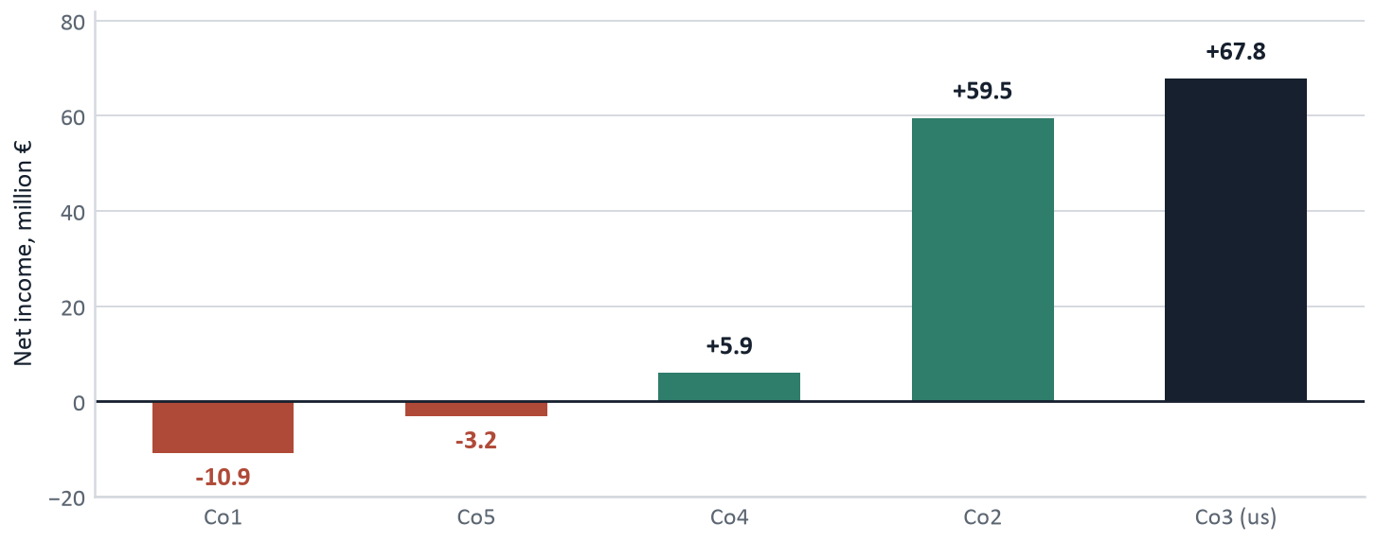
Section 2 · Summary of results
Finance Director
Main financial figures
€189.4 M
Revenue at retail price
€163,704,462 net of retailer margins
€95.7 M
Gross profit
58.5% of net revenue
€70.9 M
Operating income
43.3% operating margin
€67.8 M
Net income
41.4% net margin · ROE 50.68%
Net income of every company in the industry, million €
Reading the result
We earned €67,823,192 — more than half of the €119,254,958 the whole industry made between them.
Two of five lost money. Industry average profit margin −20.21%; ours +41.43%.
Our lead over Co2 is €8,279,120, or 13.9%.
But €40,990,251 of that profit sits in the warehouse as unsold H, and €26,497,880 of S revenue was never invoiced — we could not supply it.
Survey 23: Co1 −€10,887,540 · Co2 €59,544,072 · us €67,823,192 · Co4 €5,932,326 · Co5 −€3,157,092.
Sources: Year-1 REP p.4 (sales), p.5 (income statement), p.6 (balance sheet), p.8 (ratios); Survey 23 for rivals' net income.

Slide 9
Section 2 · Summary of results
Marketing Director
Sales and market share by product and market
Product · market | Market size | Our units | Share | Rank | What it tells us
S — market A | 10,935,676 | 5,759,496 | 52.67% | 1st | Sold out. Demand exceeded everything we could make
S — market B | 2,290,527 | 90,504 | 3.95% | 2nd | Co2 took 92.53% of B at €12.00–13.00
S — all markets | 13,264,800 | 5,850,000 | 44.10% | 1st | Every unit produced was sold; zero closing stock
H — market A | 20,162,811 | 4,556,494 | 22.60% | 3rd | Tied for the cheapest H in A and still third
H — market B | 17,892,931 | 9,989,807 | 55.83% | 1st | Clear leadership at €7.50
H — all markets | 38,115,310 | 14,546,301 | 38.16% | 2nd | Co2 beat us by 78,699 units — and we hold 17.6 M more
Both products | 51,380,110 | 20,396,301 | 39.70% | 1st | Industry leader: 20.4 M units against Co2's 18.1 M
1,827,440
Units of S demanded, not supplied
23.8% of the demand for our S brand. At €14.50 that is €26,497,880 of revenue and €12,702,797 of contribution.
17,628,699
Units of H made, not sold
121% of the H units we actually sold, carried at €40,990,251 on the balance sheet.
501,093
Units of H demanded, not served
Not a stock problem — 17.6 M units on hand and no logistic stockout flagged in any market. Shelf space or channel coverage.
Sources: Surveys 1, 2 and 3; Year-1 REP p.2–p.3 (units sold, units demanded of our brand, closing inventory). Share is our units divided by units sold by all participating companies.

Slide 10
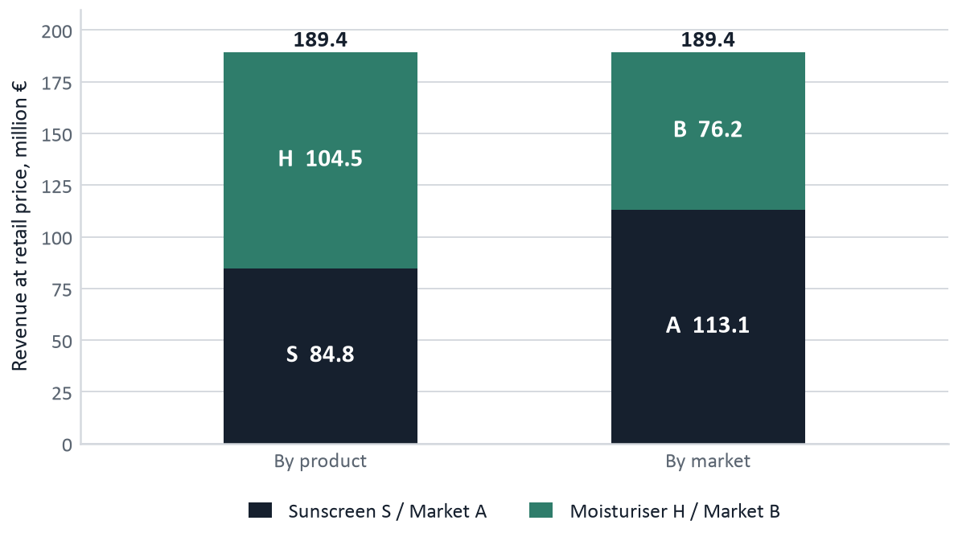
Section 2 · Summary of results
Finance Director
Revenue by product and market
 | Revenue | Share | Gross margin
Product S | €84,825,000 | 44.8% | 55.2% · €6.9511 / unit
Product H | €104,540,764 | 55.2% | 61.2% · €3.7849 / unit
Market A | €113,129,903 | 59.7% | —
Market B | €76,235,861 | 40.3% | —
Market E | €0 | 0.0% | Not entered
Total | €189,365,764 | 100% | 58.5% overall
The margin figures flatter product H
H shows a 61.2% gross margin only because the cost of the 17,628,699 unsold units is capitalised in inventory instead of charged to the P&L. Per unit sold, S earns €6.9511 of gross profit against €3.7849 for H. On the units we actually shifted, S is the product worth making — and it is the one we ran out of.
Sources: Year-1 REP p.4. S 5,850,000 × €14.50 = €84,825,000. H 4,556,494 × €6.50 in A plus 9,989,807 × €7.50 in B = €104,540,764. Market split: A €113,129,903, B €76,235,861.

Slide 11
3
Analysis and causes
Slides 12 to 24 — marketing, operations, human resources and finance.
This is the section that carries the grade. The evaluation guidelines state in capitals that it is a MUST to establish the CAUSES for the results. Nothing here is a description of what happened: every claim is paired with why it happened, what it cost, and the evidence that proves it.

Slide 12
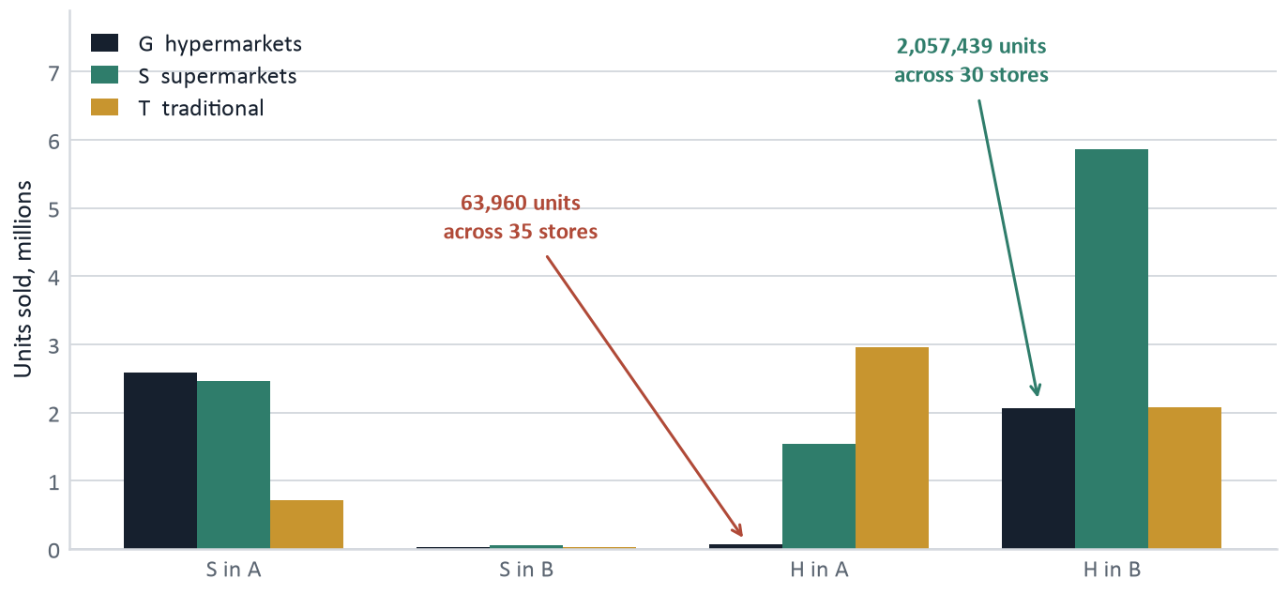
Section 3 · Analysis — marketing
Marketing Director
Portfolio, channels and positioning
Where we sell — our units by channel
Positioning vs competitors
 | Us (Co3) | Co1 | Co2 | Co4
Product S | (1, 8) | (8, 2) | (3, 8) | (2, 8)
Product H | (9, 1) | (5, 5) | (9, 1) | (1, 8)
The finding that matters
Channel G in market A took 63,960 units of our H across 35 stores — 1,827 per store. Channel G in market B took 2,057,439 across 30 stores — 68,581 per store. 37 times better.
The same 35 hypermarkets in A took 2,587,071 units of our S. The stores are not the problem and our access to them is not the problem.
Cause: channel G behaves winner-take-most. In A we are not the H brand the hypermarket buyer stocks; in B we are.
Co2 sits on our exact (9, 1) coordinates and charged €9.50–10.50 in A — identical positioning, 46% dearer, and it outsold us by 71%.
Sources: Year-1 REP p.2–p.3 (units by channel); Surveys 7 and 8 (positioning); Survey 20 (prices); Survey 27 (platforms: 35 hypermarket outlets in A, 30 in B).

Slide 13
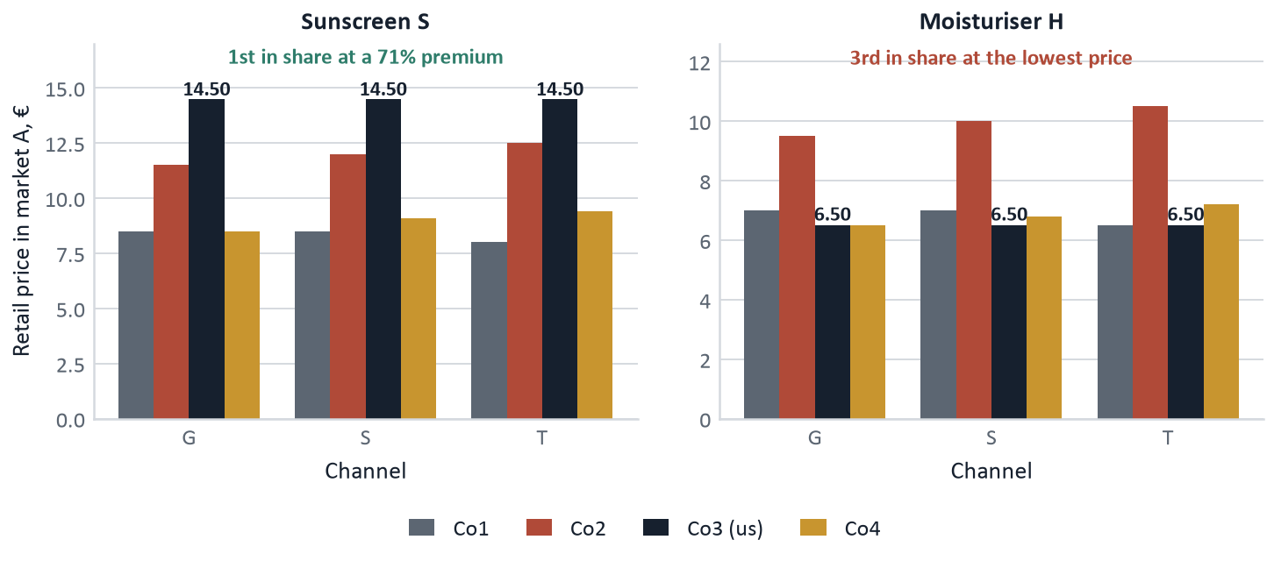
Section 3 · Analysis — marketing
Marketing Director
Price against competitors, and what it bought us
Retail price ladder, market A
+71%
Our S price above the cheapest rival
€14.50 against Co1 and Co4 at €8.50. We still took 52.67% of market A and ran out of stock.
+46%
Co2's H price above ours in market A
From our exact (9, 1) position — and Co2 sold 7,782,836 units against our 4,556,494.
€0
Spent on promotions in Year 1
Every competitor except Co5 ran at least one. We have no measurement of what a promotion is worth to us.
Conclusion on price
S is under-priced for the supply we have: selling out with 1,827,440 units unserved is the definition of it. H in market A is not losing on price — it is the cheapest on the shelf and third in share. Price is not the lever in A.
Sources: Survey 20 (retail prices by product, market and channel); Survey 22 (promotion types); Surveys 1–3 (shares). Co5 priced at zero in every cell and sold nothing.

Slide 14
Section 3 · Analysis — marketing
Marketing Director
Distribution, advertising and share of voice
Distribution
6 sales managers in A and 6 in B; none in E. Representatives A: 4 supermarket + 4 wholesale; B: 5 + 3.
Fixed sales-network cost €3,192,000; incentives €702,750 at the minimum 0.60% commission rate.
12 distribution platforms in A and 12 in B. The market-E template default of 60 was left untouched and was charged €0.
No wholesaler intermediary used — we sell through our own network only.
No logistic stockout was flagged in any market, so distribution capacity was not the constraint.
Advertising and share of voice
Campaign 18 for S and 19 for H, run in A and B, nothing in E.
Media €678,000 plus €150,000 of point-of-sale advertising = €828,000, which is 0.44% of revenue at retail price.
Weight: 12 insertions per market for S (8 television + 4 press) and 8 for H (5 television + 3 press). Television is the cheaper medium in both markets.
Share of voice is NOT measurable for Year 1. Survey 21 returns campaign identifiers, not spend, and surveys 10, 11 and 13 were not bought.
Co2 ran campaign 17 on S and campaign 19 on H — the identical campaign to ours — and outsold us in market A.
Shelf space and point of sale
Retailer margin €1.90 per unit on S and €1.00 on H. Shelf space achieved: 18% for S, 22% for H.
Point of sale: €10,000 per channel for S and €15,000 for H — €150,000 in total.
501,093 units of H were demanded and not served while 17,628,699 sat in stock with no logistic stockout. Shelf space or channel coverage is the only explanation the data leaves standing.
We cannot prove it: survey 15 (shelf space achieved) was not bought.
Year 2 buys surveys 10, 11, 13, 14 and 15 to close exactly this gap — €680,600 against a market-A shortfall worth roughly €12 M a year.
Sources: Year-1 DEP (sales network, platforms, campaigns, POP, margins, shelf); REP p.5 (general expenses); Survey 21 (rivals' campaign identifiers); Survey 27 (platforms). Surveys 11, 13, 14 and 15 were NOT bought in Year 1.

Slide 15
Section 3 · Analysis — marketing
Marketing Director
What our decisions did to demand
Lever | What we did | Measured effect on demand | Cause, and what follows
Positioning of S | (1, 8) quality corner, both markets | 52.67% of market A; demand 31% above capacity | The corner is uncontested at our price. Do not touch it
Price of S | €14.50, the highest in the industry | Sold out; 1,827,440 units of demand unserved | Too low for the supply we have, not too high for the market
Price of H in A | €6.50, tied cheapest in the market | 22.60% — third, behind two dearer brands | Price is not the A driver. We gave away margin and bought nothing
Price of H in B | €7.50 | 55.83% — clear leadership, 1st of five | The right level. Align A to it rather than cutting B
Advertising | €828,000, 0.44% of revenue | Not measurable — rivals' spend unknown | Survey 21 gives campaigns, not money. Buy 10, 11 and 13 first
Promotions | None, on either product | Co2 and Co4 both promoted H and both sold out | Untested lever. Test it on H, where we have stock to sell
Distribution | Own network, 12 platforms per market | No logistic stockout; 501,093 H units unserved | The bottleneck is shelf and channel, not vehicles
The one-sentence version
We created more demand for S than we could serve and less demand for H than we had already produced. Both failures have the same root cause: the marketing plan and the production plan were built independently of each other, and neither was tested against a measured demand curve.
Sources: Year-1 DEP (decisions as entered); REP p.2–p.3 (units sold, units demanded of our brand); Surveys 1, 2, 3, 20, 21 and 22.

Slide 16
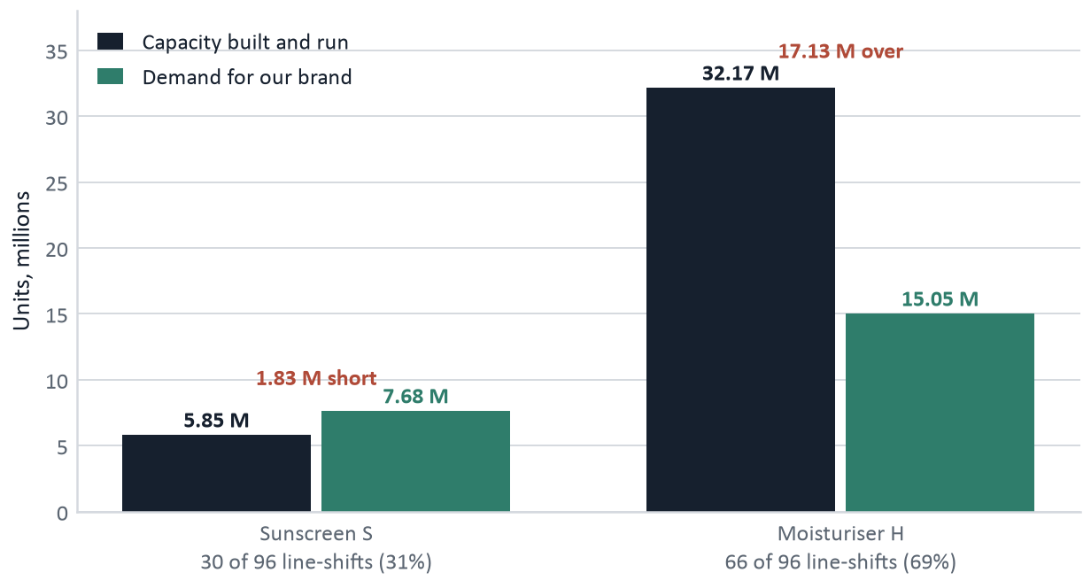
Section 3 · Analysis — operations
Operations Director
Expected against actual production
Capacity built against the demand that was there
The cause, and what it cost
We installed 32 lines — 10 for S, 22 for H — which is the legal maximum, and ran three shifts on every one of them.
That split was set before any demand had been measured. On the plant's 96 line-shifts, H was given 69% of capacity and needed 32%; S was given 31% and needed 41%.
Execution was perfect: 195,000 sellable S and 487,500 sellable H per line-shift, exactly 81.25% of nameplate. S made 5,850,000 to plan and sold all of it; H made 32,175,000 against demand of 15,047,394.
The deviation is not in the plant. The plan itself was the error.
€40.99 M
Cash locked in H stock
17,628,699 units at the €2.3252 standard cost
€12.70 M
Contribution lost on S
1,827,440 units × €6.9511 of gross profit
Sources: Year-1 REP p.2–p.4 (units produced, sold, demanded, closing inventory); DEP p.6–p.7 (lines installed, shifts, maintenance). Line-shift yields verified in model/calibration.py.

Slide 17
Section 3 · Analysis — operations
Operations Director
Unit cost and productivity
Standard cost per unit and its components, €
Component | S | H | How it is built
Raw material | 1.7335 | 1.1031 | List 1.65 / 1.05 × 1.03 terms × 1.02 yield
Labour | 3.3231 | 0.9323 | Crew cost ÷ 195,000 (S) / 487,500 (H)
Power | 0.4411 | 0.2647 | INF rate × 1.764582 realisation factor
Repairs | 0.0627 | 0.0251 | €12,224.10 per line-shift, maintenance on
Standard cost | 5.5604 | 2.3252 | Against €14.50 for S and €6.50–7.50 for H
Productivity: what worked, and what we cannot see
Utilisation measured at 81.25% of nameplate on both products, in both the test round and the graded year. It is a constant, not noise.
Preventive maintenance pays twice for its €500,000: it lifts utilisation from 78.75% to 81.25%, and it cuts the repair bill from €16,829 to €12,224.10 per line-shift. Repairs are 1.1% of unit cost.
Poka Yoke was off. §26 prices it at €720,000 per line on all 32 lines — €23,040,000 — for a single-digit output gain. It never repays.
SMED was not available in Year 1. It is the whole operations story of Year 2 (slide 28).
Raw material landed 5.1% above list on both products: 2% scrap yield plus the 3% premium for 120-day supplier terms.
We cannot benchmark unit cost. Survey 24, the industry average production cost, was not among the 11 surveys bought. It is bought for Year 2.
The cause behind the cost
Labour is 60% of the S unit cost and 40% of H, and it is fixed per line-shift. That makes unit cost a pure function of how many sellable units come off a line-shift — which is why SMED, not a cheaper supplier, is the lever that moves it. Every €0.10 of S unit cost is €668,880 at Year-2 volume.
Sources: Year-1 REP p.4 (standard costs, production results); INF (raw material list prices and power rates). All four components reproduce exactly in model/calibration.py. Survey 24, the industry average production cost, was NOT bought.

Slide 18
Section 3 · Analysis — operations
Operations Director
Supply chain, raw material and transport
Item | Year-1 result | Reference | Read, and the cause
Raw-material purchases | production × 1.02 | § scrap rule | Exact. No raw-material stockout on either product
Supplier terms | 120 days | cash available | A 3% raw-material premium costing €1,343,918, sitting in COGS
Finished-goods stockout | S: yes, 1,827,440 u | — | Capacity, not supply chain. H had no stockout and 17.6 M spare
Logistic stockout flags | none in A, B or E | — | The fleet was never the binding constraint
Factory → platform | €132,000 · €0.0065/u | €0.006/u (§10) | In line. 3 trunk vehicles in A, 2 in B, at 24,000 kg
Warehouse | €600,862 | — | Exists only because we made 17.6 M units nobody ordered
Platform → retailer | €900,000 · €0.0441/u | €0.007/u (§12) | +530% over the reference — see the cause below
Total logistics | €1,632,862 | — | 0.86% of revenue at retail price
The cause of the +530% last-mile deviation
The reference tariff is a cost per unit moved. We sized the fleet for the 37,800,000 units the plan expected to ship and moved 20,396,301 — so 50 last-mile vehicles carried 407,926 units each instead of the ~756,000 they were bought for. The fleet did not overspend; the production plan under-filled it. Year 2 cuts the last mile to 42 vehicles, which is where the risk on slide 35 lies.
Sources: Year-1 REP p.4 (production results, stockout flags, transport and warehouse cost); DEP p.2–p.3 (fleet and platforms); scenario §10 and §12 for the per-unit tariff references.

Slide 19
Section 3 · Analysis — human resources
HR Director
Headcount, turnover and pay
3,144
Production headcount
Operators and supervision, 3 shifts on all 32 lines
13
People lost in the year
4 office and management, 9 from the sales force
€306,000
Cost of that turnover
€36,000 office at €9,000 each; €270,000 sales at €30,000 each
€722,000
Selection and training
Spent, with no measurable effect on the turnover we had
Salary levels and where they sit in the permitted range
What the numbers say
Nine of the thirteen leavers came from the sales force — €270,000 of the €306,000 bill — and that is exactly where we pay the bottom of the permitted range at the minimum commission rate.
That is correlation, not proof: survey 14 (rivals' sales force) and survey 25 (industry salary) were not bought, so we cannot say rivals pay more.
The 3,144 headcount is an operations decision, not an HR one: 32 lines on three shifts, twenty of them making product that did not sell.
No salary sits above the midpoint of its range, and productivity still hit the measured ceiling of 81.25%.
Role | Our salary | Permitted range | Position
Level I | €126,000 | 108,000 – 150,000 | Lower half
Level II | €84,000 | 72,124 – 99,170 | Middle
Level III | €60,000 | 51,100 – 72,124 | Middle
Level IV | €35,000 | 30,050 – 42,075 | Middle
Operator | €13,500 | 12,000 – 16,830 | Lower half
Specialist | €24,000 | 21,000 – 29,450 | Lower half
Sales representative | €27,000 + 0.60% | 21,000 – 42,000 / 0.6 – 1.2% | Bottom of both
Sources: Year-1 REP p.4 (workforce and turnover) and p.5 (staff costs, selection and training, incentives); INF and the scenario for the permitted salary ranges. Survey 25, the industry average salary cost, was NOT bought.

Slide 20
Section 3 · Analysis — human resources
HR Director
The training department and the sales force
The training department did not pay
It cost €722,000 in Year 1 as a fixed general expense.
It buys a cheaper leaver, not fewer leavers: office replacement falls from €24,000 to €9,000 a head. Four office leavers × €15,000 = €60,000 saved.
€722,000 of cost against €60,000 of measured benefit is a net €662,000 given away, and thirteen people still left.
Year 2: switched off. If turnover repeats without it, the money goes to the sales force, where the leavers actually are.
The sales force is the real exposure
6 sales managers in A and 6 in B; representatives A: 4 + 4, B: 5 + 3. Fixed cost €3,192,000, incentives €702,750.
Pay is €27,000 against a 21,000–42,000 range, and commission is 0.60% against a 0.6–1.2% range — the bottom of both.
Nine representatives left, costing €30,000 each to replace.
We are not raising pay blind. Survey 14 measures what rivals pay; it is bought for Year 2 and the pay review happens in the Year-3 plan with evidence behind it.
What changes in Year 2, and why
Salaries are held at every level — there is no evidence a rise buys anything, and surveys 14 and 25 are unread. The training department is closed, worth +€662,000. Production headcount falls from 3,144 to roughly 1,404 as twenty moisturiser lines stand idle: that is an operations decision (slide 28) whose HR consequence is a much smaller payroll, and it is the single largest cost movement in the Year-2 plan. Two SMED specialist teams per shift are added at the €24,000 specialist rate to run the new modules. Everything else is held deliberately, so that the price and promotion experiments read against a clean background.
Sources: Year-1 REP p.4 and p.5; the turnover cost with the department switched off was measured in the test round (day 2 findings). Permitted ranges from the scenario. Survey 14 was not bought in Year 1; it is bought for Year 2.

Slide 21
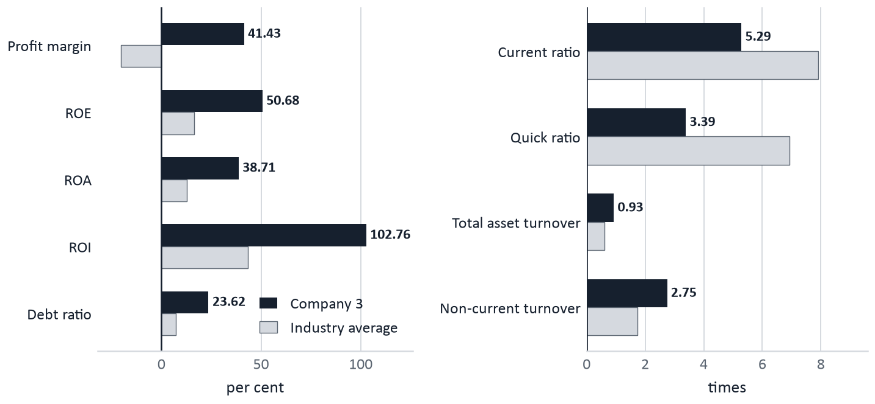
Section 3 · Analysis — finance
Finance Director
Financial statements and ratios
Our ratios against the industry average
Balance sheet at 31 December, Year 1
 | € | Comment
Cash | 46,902,208 | Idle, earning nothing
Receivables | 27,284,077 | 60-day customer terms
Inventory | 41,497,297 | 98.8% is unsold H
Non-current assets | 59,520,000 | 32 lines, net of depreciation
Total assets | 175,203,582
Payables | 15,380,390 | 120-day supplier terms
Loans | 26,000,000 | €6.5 M short + €19.5 M long
Equity | 133,823,192 | €66 M capital + €67.8 M earnings
Two readings, and one figure we will not quote
We are the most profitable and the most leveraged company at once: profit margin 41.43 against −20.21, but debt ratio 23.62 against 7.19 and current ratio 5.29 against 7.91. Both are self-inflicted and both are fixed in Year 2. We exclude the printed inventory turnover of 1.62: it does not reproduce from the statements and we will not defend a figure we cannot rebuild.
Sources: Year-1 REP p.6 (balance sheet) and p.8 (ratios, company against industry average). The printed inventory turnover is excluded — see the note.

Slide 22
Section 3 · Analysis — finance
Finance Director
Cash management: an expensively financed year
Instrument | Decision in Year 1 | Cost | Was it needed?
Loan drawn | €26,000,000 at 10%, 4-year maturity | €2,600,000 interest | No. Interest was charged on the full draw for the whole year
Loan arrangement fee | 1% of the amount drawn | €260,000 | No. The year generated €67.8 M of net income
Credit line | €10,000,000 requested, never drawn | €100,000 upfront + €100,000 service | No. €200,000 for insurance we did not use
Customer terms | 60 days — the shortest available | €27,284,077 in receivables | Yes. Already at the best available setting
Deposits | None taken | €46,902,208 earned 0% all year | A 2.5% fixed-term deposit was available from day one
Factoring / securities | Neither used | — | Correct. Nothing on the balance sheet needed funding
€3,060,000
Total financial expense
€2,600,000 interest + €260,000 loan fee + €100,000 line fee + €100,000 line service. That is 4.5% of net income, paid to borrow money we already had.
€1,343,918
Cost of 120-day supplier terms
A 3% premium on raw material. It is NOT in financial expense — it sits inside COGS, which is why it never appeared as a financing decision.
€0
Financial income earned
The cause is a single missing decision, not a market event: no deposit was opened. Year 2 opens a €10,000,000 deposit at 2.5%.
Sources: Year-1 REP p.5 (financial income and expenses) and p.6 (balance sheet); INF p.2 (interest rates, fees, penalties and terms).

Slide 23
Section 3 · Analysis — finance
Finance Director
The inventory effect on the financial position
€40,990,251
Frozen in finished moisturiser
17,628,699 units × €2.3252 standard cost. It is 98.8% of the €41,497,297 inventory line.
€46,902,208
Cash at 31 December
Against €111,774,267 in the plan — a shortfall of €64,872,059, almost all of it inventory and lower receivables.
Not a loss
It is a timing effect
Only units sold are expensed. The €40,990,251 is capitalised, so it has not touched the P&L at all.
Why it matters anyway, and what it does next
The accounting is benign and the cash position is not. We borrowed €26,000,000 and paid €3,060,000 of financial expense in the same year that €40,990,251 of cash was converted into product nobody ordered. The loan was a symptom of the inventory, not of the business.
It flatters the reported margin. H's 61.2% gross margin is calculated on the 14,546,301 units sold; the cost of the other 17,628,699 is sitting in the balance sheet, so the P&L looks better than the cash does.
It also explains two ratios on slide 21 without any financial-policy story: the current ratio of 5.29 against an industry 7.91, and the quick ratio of 3.39 against 6.93. Strip inventory out and we look illiquid; it is the difference between the two ratios.
§3 says stock does not deteriorate and sells first, FIFO. So the units are worth their full €2.3252 in Year 2 and every one sold is contribution against a cost already paid. That is precisely why Year 2 activates 2 of 22 moisturiser lines instead of 22, and why the forecast still grows.
Year-2 central forecast leaves 6,900,086 units — a 60.9% reduction — and no debt.
Sources: Year-1 REP p.3 (closing inventory), p.4 (standard costs), p.5 (income statement), p.6 (balance sheet); plan-versus-actual cash from 'anthony results + review/01-results-vs-plan.md'. Scenario §3 for FIFO.

Slide 24
Section 3 · Analysis
Managing Director
Year 1: the causes, in one table
What happened | Why it happened — the cause | What it cost | What we do in Year 2
1st in profit and in unit share | A premium position on S the market paid for, and volume leadership on H in B | — | Change nothing about either brand's positioning
S sold out; 1,827,440 units unserved | Only 10 of 32 permitted lines went to S, and the split was set before demand was measured | €26,497,880 revenue €12,702,797 contribution | SMED on the S lines: 5,850,000 → 6,688,800 units. The 32-line cap blocks anything else
17,628,699 units of H made and unsold | 22 lines on three shifts run against a demand estimate nobody validated | €40,990,251 of cash frozen | Sell the stock before making more: 2 of 22 H lines run
H took only 22.60% of market A | Lowest price on the shelf, weakest hypermarket presence — 1,827 units per store against 68,581 in B | 3rd place in the industry's largest segment | Raise A to €7.50, run a supermarket promotion, buy the 11 missing surveys
€3,060,000 of financial expense | A €26 M loan and a €10 M credit line taken against a year that generated €67.8 M | 4.5% of net income | Prepay the loan, drop the line, deposit the surplus
€722,000 on training with no effect | The department was funded without ever measuring what it changes | €662,000 net of the turnover it avoided | Close it; fund the sales force instead if turnover repeats
Sources: as cited on slides 12 to 23 — Year-1 REP p.2–p.6 and p.8, the Year-1 DEP, Surveys 1, 2, 3, 7, 8, 20, 21, 22, 23, 27 and 28, and model/calibration.py.

Slide 25
4
Objectives
Specific and measurable, built directly on the Year-1 causes Presented by the Managing Director

Slide 26
Section 4 · Objectives
Managing Director
Objectives for Year 2
Objective | Year 1 actual | Year 2 target | Change | How it is reached
Units sold — S | 5,850,000 | 6,688,800 | +14.3% | SMED lifts sellable output per line-shift from 195,000 to 222,960
Units sold — H | 14,546,301 | 14,073,013 | −3.3% | Sold out of the 17.6 M stock, not made: only 2 of 22 lines run
Sales at retail price | 189,365,764 | 205,879,597 | +8.7% | Volume on S, plus €14.50 → €15.00 and H in A €6.50 → €7.50
Net revenue | 163,704,462 | 179,097,864 | +9.4% | After retailer margins of €1.90 on S and €1.00 on H
Gross margin | 58.5% | 61.5% | +3.0 pts | Standard cost falls to €5.0853 on S and €2.1730 on H
Operating margin | 43.3% | 46.9% | +3.6 pts | Gross-margin gain, with general expenses up only 5.5%
Net income | 67,823,192 | 84,074,528 | +24.0% | The line-by-line forecast on slide 32
Return on equity | 50.68% | 38.6% | −12.1 pts | Mechanical: equity rises to €217,897,720 with no dividend proposed
Debt at 31 December | 26,000,000 | 0 | −100% | The €19,500,000 remaining is prepaid on 2 January
H stock at 31 December | 17,628,699 | 6,900,086 | −60.9% | The whole point of idling 20 moisturiser lines
Sources: Year-1 REP p.4–p.6 for the actuals; model/calibration.py for every Year-2 figure (central scenario, 32 of 32 checks reproduce the Year-1 report exactly). Market size assumed flat: the rulebook gives no growth constant.

Slide 27
Section 5 · Actions — marketing
Marketing Director
Marketing actions for Year 2
Lever | Decision entered | The Year-1 cause it answers | Value
Positioning | Unchanged: S (1, 8), H (9, 1), in A and B | Both positions delivered 1st place in their strongest market | —
Price — S | €14.50 → €15.00, every channel, A and B | Output is capped below last year's demand; the units sell either way | +€3,342,000
Price — H in A | €6.50 → €7.50 | Cheapest H in A finished third: price was never the A driver | +€2,250,000
Price — H in B | Held at €7.50 | 55.83% share at €7.50 is the best-measured price point we have | control
Promotion | H, supermarkets, A and B: 3 × €0.50 reduction | Both rivals that promoted H sold out; we have never measured one | −€662,279
Promotion on S | None | §48 rejects a promotion you cannot supply, and S has no spare units | —
Advertising | Held: campaigns 18 and 19, €678,000 + €150,000 POP | Moving the budget before surveys 10, 11 and 13 report would confound the price read | unchanged
Shelf and margin | S 18% at €1.90; H 22% at €1.00 — held | Held pending survey 15, which measures what the winners achieved | —
Market research | €166,800 → €680,600, 22 of 28 surveys | Answers why H lost market A — the single largest unexplained gap | −€680,600
Sources: the Year-2 decision sheet as submitted (15 screens, recorded in 07-YEAR-2-DECISIONS-AS-ENTERED.md); values computed in model/calibration.py against the central elasticity. Decisions are already entered.

Slide 28
Section 5 · Actions — operations
Operations Director
Operations actions for Year 2
Capacity and production
Supply chain and logistics
Decision | Year 2 | Why
New production lines | None | 10 S + 22 H already hits the 32-line legal cap
SMED modules | 2, at €6,000,000 | The only capacity lever left: 81.25% → 92.9%
Poka Yoke | No | €720,000 × 32 lines = €23,040,000. Never repays
Shifts | 3 | Unchanged. The constraint is the line, not the hours
Preventive maintenance | Yes, €500,000 | Pays twice — utilisation and repair cost
S lines activated | 10 of 10 | S is the constrained product; every line runs
H lines activated | 2 of 22 | 17.6 M units are already made. Sell them first
S output | 6,688,800 u | 10 lines × 3 shifts × 222,960 sellable
H output | 3,344,400 u | 2 × 3 × 557,400 — tops stock up to 20,973,099
Decision | Year 2 | Why
Raw material — S | 6,578,235 u | Output × 1.02 scrap × 1.01 buffer, less stock
Raw material — H | 3,446,019 u | The same rule on the reduced H run
Supplier payment | Cash | Drops the 3% terms premium: +€434,174
Platforms | 12 A · 12 B · 60 E | E left at the template default, which costs €0
Trunk vehicles | 2 in A, 2 in B | Year 1 moved 20.4 M units on 5 with no flag
Last-mile vehicles | 24 in A, 18 in B | Down from 30 and 20 — saves €170,400
The trade to test us on
€6,000,000 of SMED replaces new lines we are not permitted to build and pays back in 0.65 years: +€9,160,000 of contribution in Year 2 alone. Idle H lines still carry depreciation whether they run or not, and that is in the forecast.
The one live risk
Cutting the last mile from 50 to 42 vehicles raises the load per vehicle by 20.7% with no measured headroom, to save €170,400. The test round showed a €1,527,519 emergency premium on a single flagged market. It is on slide 35.
Sources: the Year-2 decision sheet as submitted; scenario §26 (Poka Yoke), §48; outputs and standard costs from model/calibration.py at the 92.9% SMED utilisation measured in the test round.

Slide 29
Section 5 · Actions — human resources
HR Director
HR actions for Year 2
Decision | Year 1 | Year 2 | Why | P&L effect
Salary levels I–IV | 126 / 84 / 60 / 35 k€ | Unchanged | Office turnover was 4 people and €36,000. No evidence a rise buys anything, and survey 25 is unread | €0
Operator and specialist pay | €13,500 / €24,000 | Unchanged | Rates held; the payroll falls because headcount falls, not because pay does | lower total
Production headcount | 3,144 | ~1,404 | Twenty moisturiser lines stand idle — the operations decision on slide 28 | largest saving
Recruitment and training | Yes — €722,000 | Closed | It bought €60,000 of measured turnover saving for €722,000 | +€662,000
Sales force pay and rate | €27,000 + 0.60% | Unchanged | We sit at the bottom of both ranges, but survey 14 reports this year — no blind rise | €3,192,000 fixed
Sales incentives | €702,750 | 0.60% of net price | Rate held at the minimum; the euro amount follows the plan's volume | moves with volume
SMED specialist teams | None | 2 teams per shift | Required to operate the two SMED modules; paid at the €24,000 specialist rate | new cost
Sources: the Year-2 decision sheet as submitted; Year-1 REP p.4–p.5; permitted ranges from the scenario; the turnover cost with the training department off was measured in the test round.

Slide 30
Section 5 · Actions — finance
Finance Director
Finance actions for Year 2
Instrument | Year 2 decision | Why | Effect
New loan | None | Year 1 proved the business self-funds: €67.8 M of net income against a €26 M draw | —
Existing loan | Prepay the full €19,500,000 | A 1% penalty of €195,000 cancels €1,950,000 + €1,300,000 + €650,000 of interest across Years 2 to 4 | +€1,755,000 in Y2
Credit line | Reduced from €10,000,000 to zero | It cost €200,000 in Year 1 — 1% upfront and 1% service — and was never drawn | +€200,000
Fixed-term deposit | €10,000,000 at 2.5% | €46.9 M of cash earned nothing all of Year 1. Early withdrawal costs only 1% | +€250,000
Supplier terms | Moved to cash, both products | 120 days carried a measured 3% raw-material premium — €1,343,918 in Year 1 | +€434,174
Customer terms | 60 days — unchanged | Already the shortest setting available; receivables are 2/12 of net revenue | —
Market research | €166,800 → €680,600 | 22 of 28 surveys, including 10, 11, 13, 14 and 15 — the market-A diagnosis | −€680,600
€3.06 M → +€55 k
The financial line reverses
−€195,000 penalty + €250,000 deposit interest. A €3,115,000 swing.
Zero debt
Balance sheet at 31 December
Against €26,000,000 of borrowings a year earlier.
€680,600
Bought as information
Against a market-A moisturiser gap worth roughly €12 M a year, this is not a cost.
Sources: the Year-2 decision sheet as submitted; INF p.2 (rates, fees, penalties); Year-1 REP p.5–p.6; model/calibration.py.

Slide 31
6
Financial forecast
Projected income statement · The forecast band · Alternatives rejected · What we left on the table Presented by the Finance Director and the Managing Director

Slide 32
Section 6 · Financial forecast
Finance Director
Projected income statement for Year 2
Income statement, € | Year 1 actual | Year 2 central | Change | What drives the change
Sales at retail price | 189,365,764 | 205,879,597 | +8.7% | S 6,688,800 × €15.00; H 14,073,013 at €7.50 in A and B
Retailer margins | (25,661,301) | (26,781,733) | +4.4% | €1.90 per unit of S, €1.00 per unit of H
Net revenue | 163,704,462 | 179,097,864 | +9.4%
Cost of sales | (67,984,261) | (68,873,477) | +1.3% | S at €5.0853; H sold FIFO out of stock carried at €2.3252
Gross profit | 95,720,201 | 110,224,387 | +15.2% | Margin on net revenue 58.5% → 61.5%
General expenses | (24,837,009) | (26,204,859) | +5.5% | Depreciation €7,200,000, research €680,600, training closed
Operating income | 70,883,192 | 84,019,528 | +18.5% | Operating margin 43.3% → 46.9%
Financial income / (expense) | (3,060,000) | 55,000 | +3,115,000 | €250,000 of deposit interest less the €195,000 prepayment penalty
Net income | 67,823,192 | 84,074,528 | +24.0% | Net margin 41.4% → 46.9%
What is deliberately not in this forecast
No credit is taken for any volume lift from the moisturiser promotion — it is carried at its full €662,279 cost and zero benefit, because we have never measured one. No market growth is assumed. No rival capacity change is assumed, and the largest unmodelled risk is Company 4 adding a third shift.
Sources: Year-1 actuals from REP p.4–p.6. Year-2 central scenario from model/calibration.py, at H elasticity −0.9 and the decisions on slides 27 to 30. Retailer margins and cost of sales are the arithmetic difference of the lines above.

Slide 33
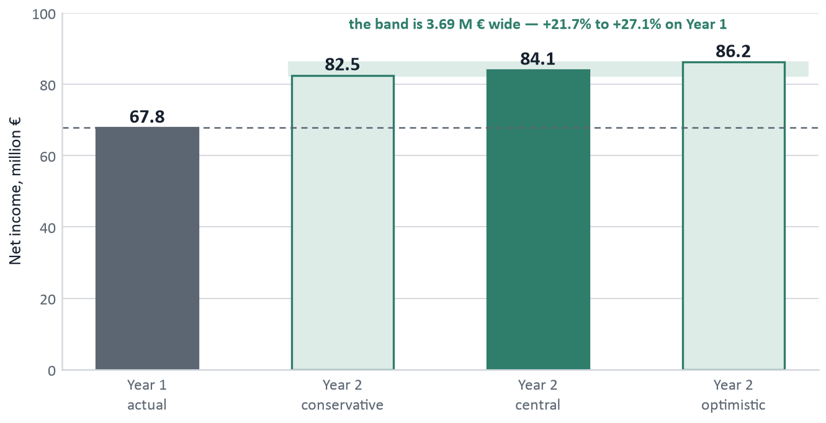
Section 6 · Financial forecast
Finance Director
The forecast is a band, not a point
Net income, Year 1 actual and the three Year-2 scenarios
 | Conservative | Central | Optimistic
H elasticity in A | −1.6 | −0.9 | −0.9
H units sold | 13,650,606 | 14,073,013 | 14,646,445
Net revenue | 176,352,218 | 179,097,864 | 182,825,174
Operating income | 82,456,510 | 84,019,528 | 86,147,865
Net income | 82,511,510 | 84,074,528 | 86,202,865
vs Year 1 | +21.7% | +24.0% | +27.1%
H stock 31 Dec | 7,322,493 | 6,900,086 | 6,326,654
What has to go wrong
Every scenario clears Year 1's €67,823,192. The worst demand case is +21.7%.
S is unaffected in all three: output caps sales, so extra demand becomes unserved demand and carries into Year 3.
A second, independent uncertainty: if prepaying on 2 January does NOT stop the year's interest, every figure drops €1,950,000 (question 2 for the board).
Across both uncertainties the full band is €80,561,510 to €86,202,865 — every corner still beats Year 1 by at least 18.8%. We headline the central €84,074,528 but commit publicly only to the €80,561,510 floor: over-promising is precisely what Year 1 got wrong.
Sources: model/calibration.py. The three scenarios differ only in the moisturiser elasticity in market A: −1.6 conservative, −0.9 central and optimistic. S is capacity-capped at 6,688,800 units in all three.

Slide 34
Section 6 · Financial forecast
Managing Director
Alternatives we costed and rejected
Alternative considered | What it would do | Why we rejected it
Build no SMED — run the Year-1 plant | S stays at 5,850,000 units | Repeats the Year-1 stockout and forfeits €9,160,000 of contribution
Buy a third SMED module for €3,000,000 | Utilisation is already 92.9% with two | The residual headroom cannot repay €3 M inside the four-year rule
Deploy Poka Yoke | €720,000 per line × 32 = €23,040,000 | Almost four times the SMED spend for a fraction of the output gain
Run 4 H lines instead of 2 | +3,344,400 units of H stock | Ties up more cash in a product of which we already hold 17.6 M units
Price S at €15.50 or €16.00 | Both are at or below the clearing price | We did not take this, and it is the first item on slide 35 — a known miss
Price H in market B at €8.75 | +€5.47 M at −0.9, +€0.64 M at −1.6 | Also not taken. Second item on slide 35
Run the promotion in market A only | Cost €64,000 instead of €662,279 | Same information, €598,279 cheaper. Fourth item on slide 35
Keep the loan instead of prepaying | −€1,755,000 in Year 2 | Pays 10% on money we would simultaneously deposit at 2.5%
Keep the €10 M credit line | −€200,000 | Insurance against a trough the Year-2 cash plan shows cannot occur
Enter market E in Year 2 | 98,165 units were sold there by everyone | S is supply-capped and 17.6 M units of H must clear at home first
Sources: model/calibration.py, each line changing one variable against the central case of €84,074,528; scenario §26 (Poka Yoke price per line), §18 (promotion types), §48. Capital expenditure is treated as cash on 2 January.

Slide 35
Section 6 · Financial forecast
Managing Director
What we know we left on the table
Year 2 is already submitted. These five are stated as known, quantified positions with a Year-3 correction — not as regrets.
# | The weakness, stated plainly | What it costs | The Year-3 correction
1 | S at €15.00 is below the clearing price at every defensible elasticity. The clearing price is €15.32 at −2.5 and €16.27 at −1.2 | €2.15 M – €8.46 M central €5.99 M | Price S at or above the clearing price computed from the Year-2 demand line. ~608,000 units go unserved a second year, and §34 says that damage outlives the year
2 | H in market B held at €7.50, when €8.75 beats it at BOTH ends of the elasticity range and the nearest rival sells at €10.00–11.00 | €5.47 M at −0.9 €0.64 M at −1.6 | Move B to €8.75–9.50. It is the best-measured price point in the game: 55.1% share at €7.75 and 55.8% at €7.50
3 | Both products are now priced identically in A and B, which gives up the within-year cross-market elasticity read | a year of measurement | Always run two different prices for one product in one year. It costs nothing to type and it is the only clean way to recover an elasticity
4 | The promotion runs in both markets rather than one, so there is no untouched control market | €598,279 more than the answer required | One market, one channel, never a whole product line. Market A alone would have cost €64,000 and kept B as a clean control
5 | The last-mile fleet is cut 20.7% per unit with no measured headroom on where the stockout flag sits | risk, not cost: ~2× if it flags | Restore the fleet the moment Year 2 shows a logistic stockout flag. The test round saw a €1,527,519 premium on one market
The honest total
Roughly €11.8 M left on the table against roughly €12.1 M of value created. Every item is a price field that cost nothing to type — which is exactly why we are showing them to the board rather than waiting for the result sheet to.
Sources: model/calibration.py, clearing-price and elasticity analysis in 08-YEAR-2-DECISION-REVIEW.md; scenario §34 (stockout brand damage) and §18. Test-round measurement for the logistic emergency premium.

Slide 36
Where we need the board
Managing Director
Questions for the board, and our commitments
Five questions we cannot answer from the data
What we commit to for Year 2
1
What determines the shelf space a brand actually gets in a channel? Thirty-five hypermarkets in A took 63,960 units of our moisturiser; thirty in B took 2,057,439.
~€12,000,000 a year · asked by the Marketing Director
€80.6 M
of net income at the worst corner of the band — up 18.8% on Year 1
2
Does a prepayment on 2 January stop that year's interest, or is it charged on the 1 January opening balance regardless?
€1,950,000 · asked by the Finance Director
6,688,800
units of S, sold out, every line running with SMED
3
What does it take to open market E? The whole industry sold 98,165 units into 110,100,000 of potential, and we hold 20 idle moisturiser lines.
20 paid-for lines · asked by the Managing Director
6,900,086
units of H stock left, down 60.9% from 17,628,699
4
How large is the §34 stockout penalty, and how many years does it run? We left 1,827,440 units of sunscreen demand unserved.
€2,150,000 to €8,460,000 · asked by the Operations Director
Zero
debt on the balance sheet at 31 December
5
Does the retailer margin buy us anything, or is it purely a deduction? We paid €25,661,301 of it in Year 1.
€25,661,301 paid in Year 1 · asked by the Marketing Director
No. 1
held on net income and on accumulated profit
Thank you — we are ready for your questions.
Sources: Year-1 REP p.2-p.6; INV surveys 1, 2, 3, 20; INF p.2; scenario §34, §41, §42. Full briefing behind each question in 10-QUESTIONS-FOR-THE-CEO.md.

